Slide 1



Chainlink Fall Hackathon
DataFi
Let People make best use of data
2020.11

Slide 2

Contents
1
Backgrounds
2
DataFi
3
Future Visions

Slide 3

Background - The World of Data
Data is everywhere
People have no control of their data
People disclose their privacy without corresponding service or payoff

Slide 4
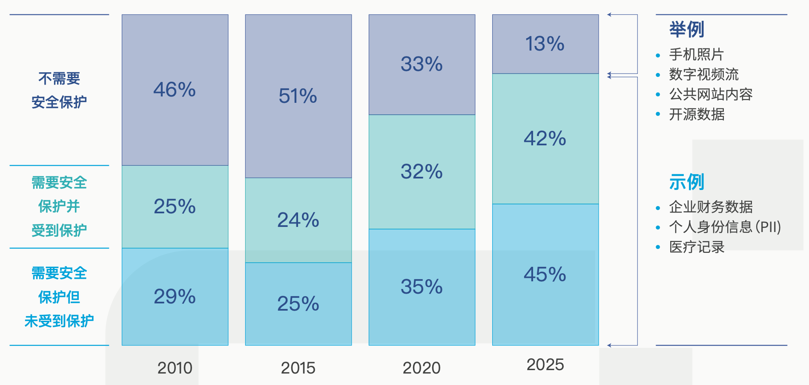
Background - Trends
Algorithm everywhere
Examples:
Webpage contents
Open source data
Algorithms have pervaded into people’s lives. Data is indispensable and of great value in the whole internet industry as well as the platform economy.
Not Privacy
Protected
Privacy
Company’s financial data
Clinical records
Personal ID&data
Privacy & Security
Un-protected
Privacy
Data involve personal privacy could undermine people’s welfare in cases such as privacy disclosure and price discrimination.
Global Trends on Data Security

Slide 5
Contents
1
Backgrounds
2
DataFi
3
Future Visions

Slide 6
DataFi – make data worth
Our Goals
We will provide service on building Data markets and searching for its equilibrium.
To be more specific, DataFi allows individuals to have control of their data, make best use of their data and get appropriate payoff – including enjoying better and secured service, and getting paid.
DataFi
Data Minting
Usage Auditing
Smart Contracts
Approval of using
Data Owner
Data User
Payoff (service/compensate)

Slide 7
ERC721D – Data version NFT
ERC 721D
Read it rather than own it
function read(uint256 tokenId) external returns (uint256);
Approve
Authorize
One can approve people to transfer the data.
Data owner and people approved by the data owner can authorize others to access the data.

Slide 8
An Example – Scholarship Verification
Data
DataFi
Mint Data with Chainlink
The student’s private personal information, such as GPAs, IDs, etc.
Auditing
Smart Contracts
Data Owner- students
Data User- schools
Services
Approve
Verifying the data and handing out the scholarship.
The open source contract guarantees the data won’t be used for other purpose.
Verify and Hand out Scholarship

Slide 9
Scholarship Verification Con’t
1. Mint
Mint the data as ERC721D using Chainlink
2. Verification
The school creates a scholarship verification contract
Students aprrove the contract to read their data
As user of the ERC-x data, the contract read and verify student’s GPAs, IDs, etc.
The contract hands out the scholarships according to the verification results.

Slide 10
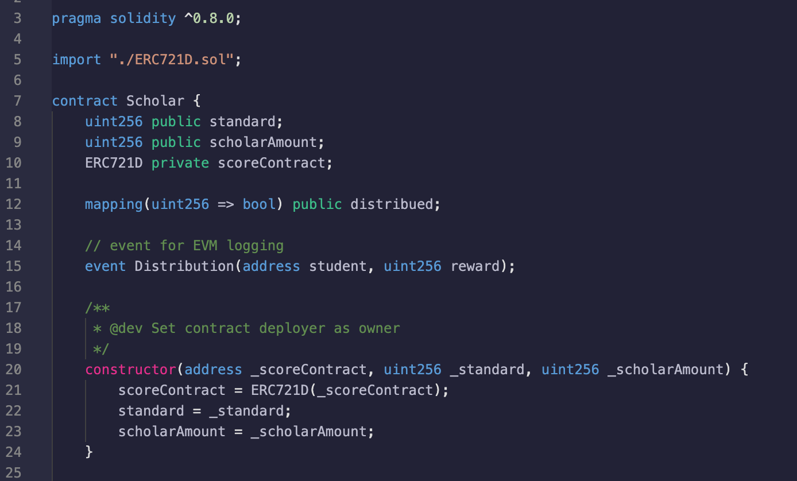
Scholarship Verification Con’t

Slide 11
Contents
1
Backgrounds
2
DataFi
3
Future Visions

Slide 12
Application Scenarios
Data Owner
Connections and Trust
Built by DataFi
Data User
Secured
Services
Enabling
Privacy Protecting
Platforms
App users
DataFi
Governments
Devices owners
Market Failing
Preventing
Data Scientists
Data
trading
…
…

Slide 13
THANKS
2021.11

